Slide 1

Design of Experiments The Lego Project
Team D-16
Shitij Gusain
Che-Chih Lee
Kuan-Chih Lee
Akash Deep Kumar

Slide 2
Objective
The main goal of the Lego Project - Design of Experiments is to build a Lego car under a budget to cover the maximum distance horizontally. We would achieve this by optimizing the design to maximize efficiency while keeping the cost constraints in mind.

Slide 3
Ramp Dimensions and build:
A ramp of length 24 inches is considered which is set at an angle of 29 degrees . The ramp is positioned with the help of 2 mid-sized cardboard boxes.
Simulation (the setup)
Overview:
Number of Models: 3
Model 1: Not optimal at all – high cost and less efficient.
Model 2: Decreased cost however no improvement in distance covered.
Model 3: Enhanced the car dimensions by changing the 3 factors.
Experiment Environment:
In order to learn about the impact of external factors on the experiment, we conducted the experiment indoors (on wooden flooring with regulated air flow) and outdoors (on concrete flooring with unregulated air flow).
Note: All the experiments were performed on the same day. (No Blocking/Confounding)

Slide 4
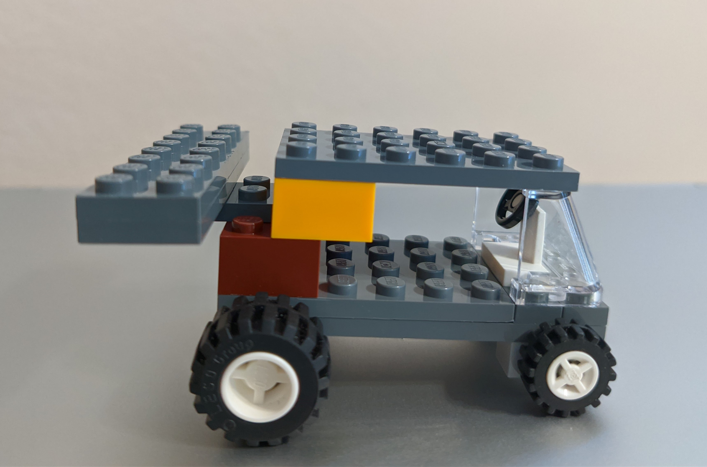
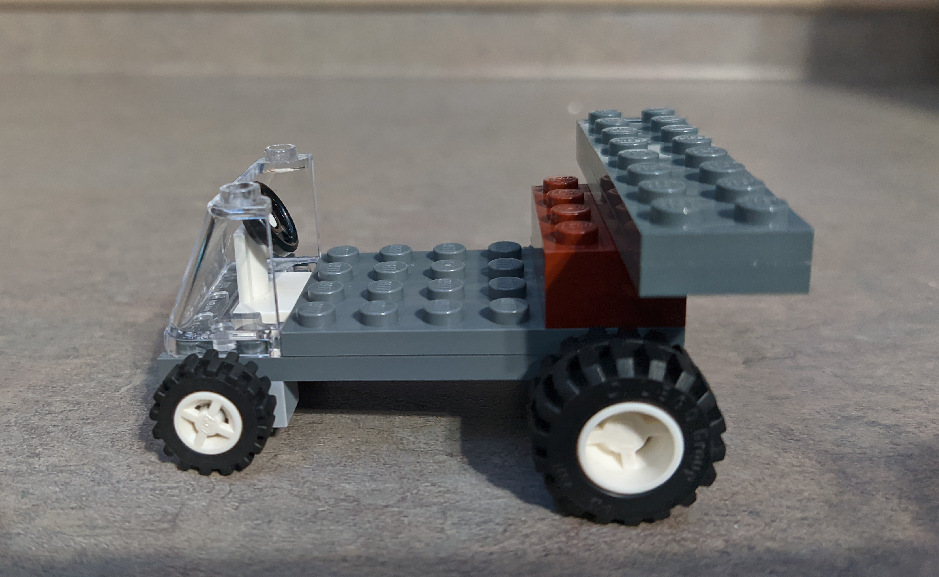
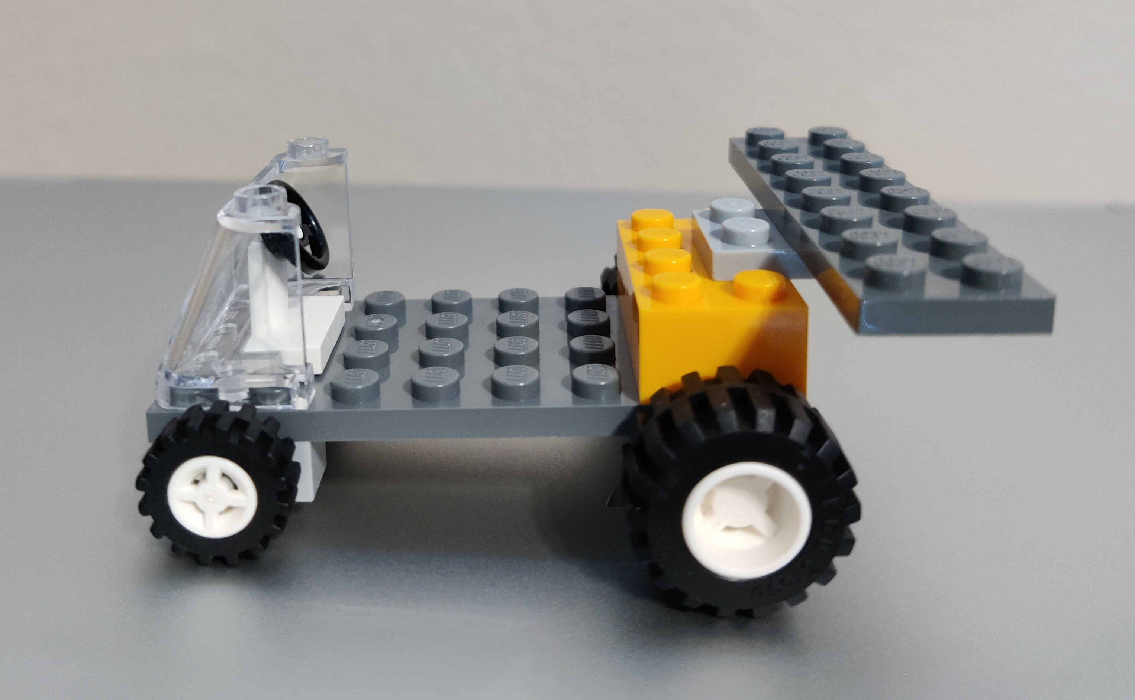
Bulky Car:
In Action:
The car was released from the head of the ramp and the distance covered was measured using a measuring scale.
Simulation.. continued
Average Performance:
Optimized Model:

Slide 5

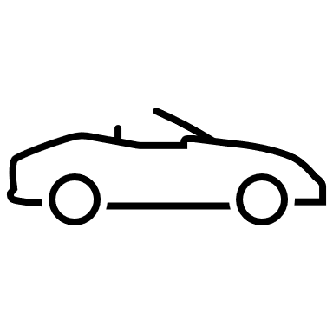

Factor 1: Size of Rear Wheel
Wheels of different sizes were provided, and we decided to use that as a factor. We swapped the rear wheel with bigger ones and ran the experiments.
Level -1: Small Wheels
Level +1: Big Wheels
Factor 2: Height of the Windshield
Windshield not only provides strength and protection to the car, but the inclination of the windshield helps the car to move past the wind speed. We decided to play around with the height of the windshield and observe the performance of the car.
Level -1: Windshield at lower height
Level +1: Windshield at higher height
Factors
Factor 3: Spoiler (with/without)
As we know that a spoiler helps in enhancing the speed by creating a downforce and creating better airflow. Therefore, we used that as a factor as it would help the car move farther. Level -1: Without Spoiler
Level +1: With Spoiler

Slide 6
Factors Levels
Factor No. | Factor | Level 1 (-1) | Level 2 (1)
A | Rear Wheel Size | Small | Large
B | Windshield Height | Low | High
C | Spoiler | Without | With

Slide 7
Assumptions:
We have considered 3 factors with high and low levels (as seen in the previous slides) resulting to 8 combinations. We ran 3 replicates. Total 24 runs.
Since we did the experiments in different environmental conditions(indoor and outdoor), that helped us learn the impact of external factors on our product.
We strictly used the Lego parts provided to us.
We followed a basic car structure that includes a windshield, a steering wheel, a base and 4 wheels(making the chassis).
Assumptions
and
Challenges
Challenges:
It was difficult to decide the factors that would enhance the car performance.
The Lego pieces were of predefined shapes which did not help us get the desired shape.
The height, weight and length of the car were also hard to determine.

Slide 8
Main & Interaction Effects

Slide 9
Results and Interpretations
In order to interpret our experiments, we used Minitab to obtain results and here they are:
This is the Residual results from based on the inputs from our experiments.
Normality – The Normal Probability plot seems satisfactory since it almost passes the fat pencil test.
The Histogram also looks good which means that the data is normally distributed.
The Plots for equal variance also looks good.
The data looks good as we don’t seem any patterns and trends which says that the data points are randomly placed

Slide 10
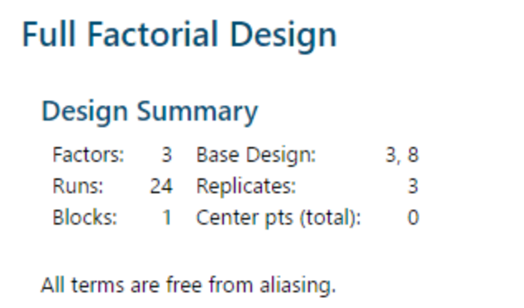
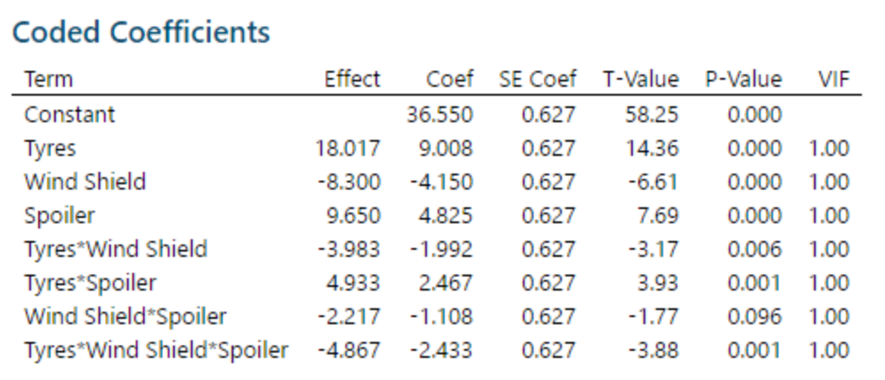
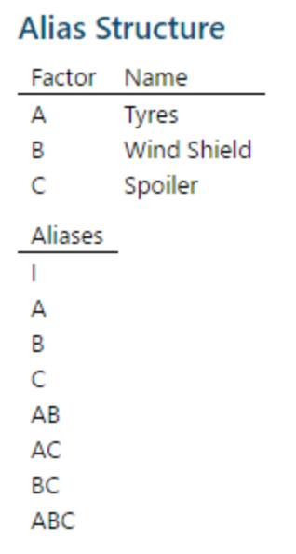
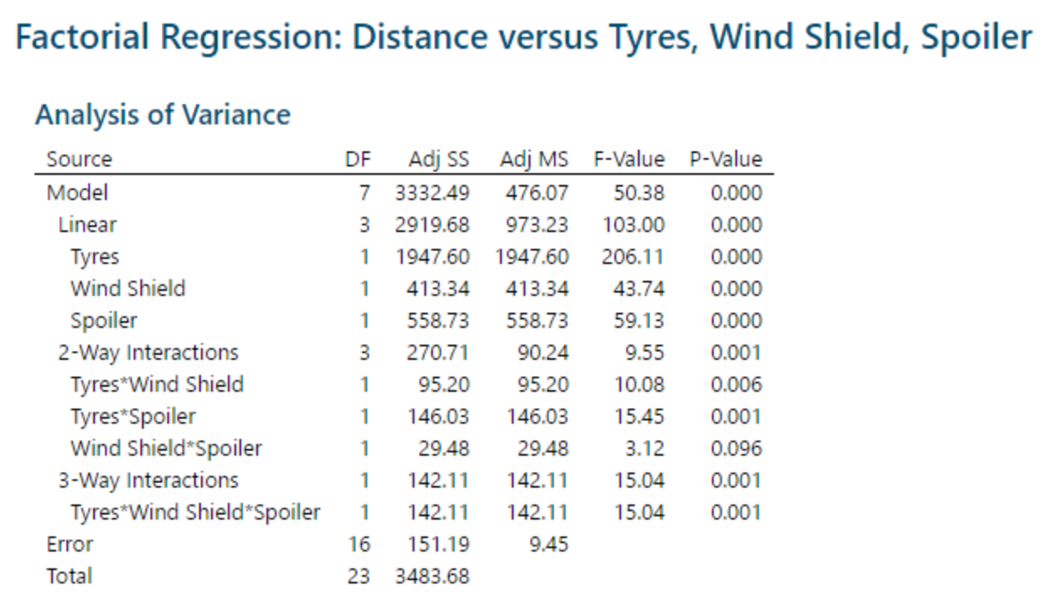
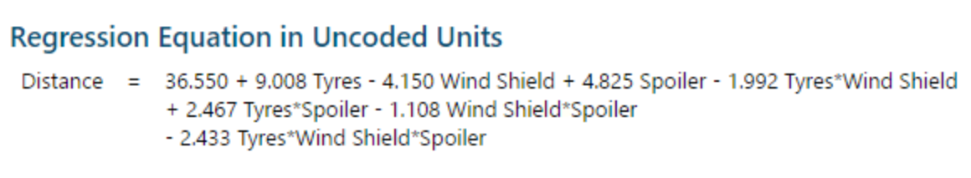
ANOVA
First Run
Assume that A = Tires (+: Large -: Small)

Slide 11
Pareto and Significance Analysis

Slide 12
Results and Interpretations
(After dropping Height of Windshield*Spoiler)
We drop the interaction of Windshield height and Spoiler and review the residual results.
Normality – This seems to be better than the previous results with more data points passing the fat pencil test.
The Histogram is skewed to the left due to 1 outlier.
The Plots for equal variance also looks satisfactory, better than the previous run.
The data points also pass the Randomization test.

Slide 13
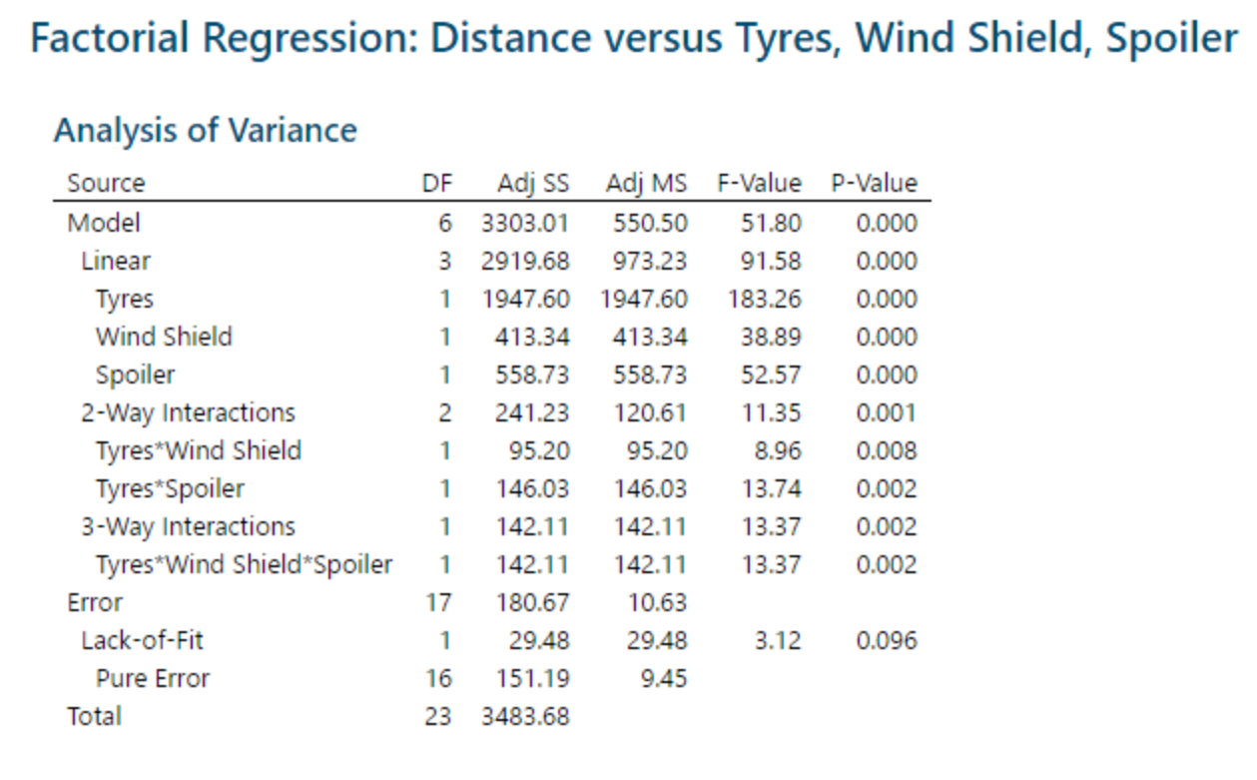
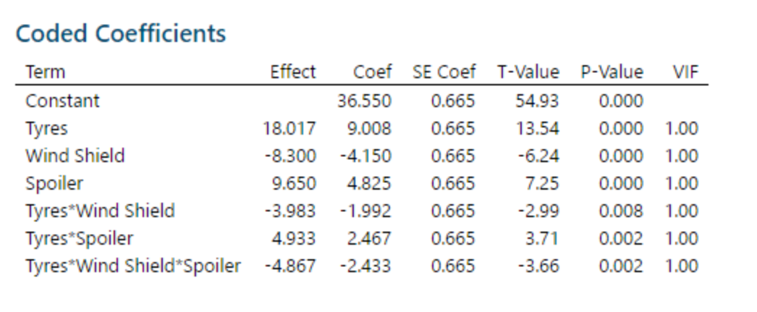
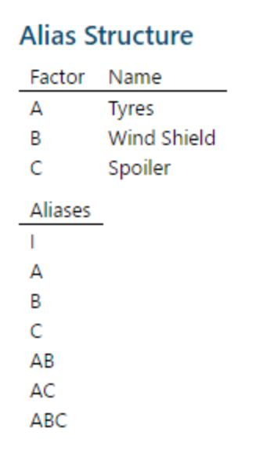
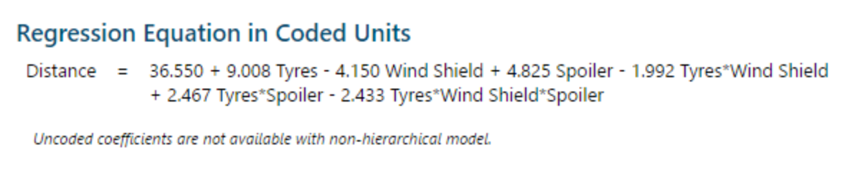
ANOVA

Slide 14
Pareto and Significance Analysis

Slide 15
Estimate Analysis
Because our optimized model comprises three components and two levels, we compared the eight alternative models.
The data demonstrates how much money is spent on various models with various Lego parts combinations.
The deal is between the increasing cost and maximum distance traveled, and our Lego model is clearly the best option in terms of distance traveled and related expenditures, according to the financial analysis.
Model1 |  |  | Model 2 |  |  | Model 3 |  |  | Model 4
Steering | 100 |  | Steering | 100 |  | Steering | 100 |  | Steering | 100
Windshield (small) | 500 |  | Windshield (small) | 500 |  | Windshield (small) | 500 |  | Windshield (small) | 500
2*2 block piece | 500 |  | 2*2 block piece | 500 |  | 2*2 block piece | 500 |  | 2*2 block piece | 500
Small Front wheels | 1000 |  | Small Front wheels | 1000 |  | Small Front wheels | 1000 |  | Small Front wheels | 1000
2*4 block piece | 1000 |  | 2*4 block piece | 1000 |  | 2*4 block piece | 2000 |  | 2*4 block piece | 2000
2*8 block piece | 0 |  | 2*8 block piece | 1200 |  | 2*8 block piece | 1200 |  | 1*8 block piece | 0
Small Rear Wheels | 1000 |  | Small Rear Wheels | 1000 |  | Small Rear Wheels | 1000 |  | Small Rear Wheels | 1000
4*10 base | 2200 |  | 4*10 base | 2200 |  | 4*10 base | 2200 |  | 4*10 base | 2200
2*2 Block Piece/Tires | 4000 |  | 2*2 Block Piece/Tires | 4000 |  | 2*2 Block Piece/Tires | 4000 |  | 2*2 Block Piece/Tires | 4000
Model Cost | 10300 |  | Model Cost | 11500 |  | Model Cost | 12500 |  | Model Cost | 11300
Model5 |  |  | Model 6 |  |  | Model 7 |  |  | Model 8 (OPTIMAL)
Steering | 100 |  | Steering | 100 |  | Steering | 100 |  | Steering | 100
Windshield (small) | 500 |  | Windshield (small) | 500 |  | Windshield (small) | 500 |  | Windshield (small) | 500
2*2 block piece | 500 |  | 2*2 block piece | 500 |  | 2*2 block piece | 500 |  | 2*2 block piece | 500
Small Front wheels | 1000 |  | Small Front wheels | 1000 |  | Small Front wheels | 1000 |  | Small Front wheels | 1000
2*4 block piece | 2000 |  | 2*4 block piece | 2000 |  | 2*4 block piece | 1000 |  | 2*4 block piece | 1000
2*8 block piece | 1200 |  | 1*8 block piece | 0 |  | 1*8 block piece | 0 |  | 2*8 block piece | 1200
Large Rear Wheels | 2000 |  | Large Rear Wheels | 2000 |  | Large Rear Wheels | 2000 |  | Large Rear Wheels | 2000
4*10 base | 2200 |  | 4*10 base | 2200 |  | 4*10 base | 2200 |  | 4*10 base | 2200
2*2 Block Piece/Tires | 4000 |  | 2*2 Block Piece/Tires | 4000 |  | 2*2 Block Piece/Tires | 4000 |  | 2*2 Block Piece/Tires | 4000
Model Cost | 13500 |  | Model Cost | 12300 |  | Model Cost | 11300 |  | Model Cost | 12500

Slide 16
Analysis of all models based on Estimate and Distance Covered

Slide 17
Considering the factors and using the various Lego pieces provided to us we compare the performance of the 3 models. In the table beside we have the results of all the models and, we can conclude that model 8 is the best amongst all the others.
Overall Model Comparison
Model | Description | Total Cost | Average Distance
1 | Small Tyres, Small Windshield Height, Without Spoiler | 10300 | 28.667
4 | Small Tyres, Large Windshield Height, Without Spoiler | 11300 | 21.700
7 | Large Tyre, Small Windshield Height, Without Spoiler | 11300 | 40.867
2 | Small Tyres, Small Windshield Height, With Spoiler | 11500 | 30.733
6 | Large Tyre, Large Windshield Height, without spoiler | 12300 | 35.667
3 | Small Tyres, Large Windshield Height, With Spoiler | 12500 | 29.067
8 (Optimal) | Large Tyre, Small Windshield Height, With Spoiler | 12500 | 62.533
5 | Large Tyre,Large Windshield Height, With Spoiler | 13500 | 43.167
 | COST | AVERAGE DISTANCE
MODEL 1 | 19700 | 55.01
MODEL 2 | 15200 | 59.39
MODEL 3 | 12400 | 62.53

Slide 18
Conclusion
Based on the Effects plot we can conclude that
Rear Wheel Size level +1(bigger wheels) impacts the performance of the car as it travels farther.
Windshield height level -1(low), higher windshield only obstructs the speed of the car.
Spoiler level +1(present), it helps the car to cut through airflow and enhance the speed.

Slide 19
Recommendation
1.) Experiments demonstrated better results when they were performed in a controlled environment with no external factors, the outcome seemed to have no anomaly, as the floor has less friction and the wind speed was not obstructing or enhancing the performance.
2.) The car design was quite important as more weight just added to the slowness in speed which would eventually made it travel for a shorter distance. Not only that it also added to the cost component as we used more Lego pieces.
3.) The DOE concepts helps to randomize the samples and hence gives us a better idea of how the product would perform at different instances.
4.) There are some other factors that might hamper the recordings
Measurement of the distance covered can cause repeatability/reproducibility issues.
The way the car is launched on the ramp also impacts the distance traveled.
The ramp in itself can cause variability in performance as an unstable ramp might cause noise in the data and tarnish the accuracy of the experiment.
Thank you!

